Slide 1

Infrastructure as Code: Deploying Elasticsearch and Kibana with Terraform
Presented by: Alam Ahmed

Slide 2

Agenda
What We'll Cover Today
Introduction
Why Infrastructure as Code?
Benefits and challenges
Project Overview
What we're building
Architecture walkthrough
Live Demo
Deploy infrastructure with Terraform
Access Elasticsearch and Kibana
Code Walkthrough
Best practices
Discussion
Next steps

Slide 3
Who I’m I
Alam Ahmed NOC System Engineer + Network Engineer
Experience: 3 years in Tech Specialization: Cloud Infrastructure, Network Security, Infrastructure as Code
Certifications: 13 AWS, 3 FortiGate, 300+ Microsoft, 79 Meraki/Cisco, 3 Cilium, 5 Linux
Education: BSc Business Management (De Montfort), Level 3 Cybersecurity (Serco)
Open Source: Envoy AI Gateway - Author & Technical Contributor
Passionate about Iac and Cloud

Slide 4
Why Infrastructure as Code for Elastic?
The Challenges of Manual Deployments
🛑 "Works on my machine" syndrome – Inconsistent configurations 🛑 Snowflake environments – No two deployments alike 🛑 Slow scaling – Hours to provision new resources 🛑 Mystery outages – No change history for troubleshooting
[Manual] 🚧 ---vs--- 🏗️ [Terraform]
│ Slow - weeks │ Fast
│ Fragile │ Reliable
│ No history │ Git-tracked

Slide 5
Component | Details
EKS Control Plane (Managed by AWS) | API Server – Handles Kubernetes API requests Scheduler – Assigns pods to nodes Controller Manager – Manages cluster state etcd – Distributed key-value store
Worker Node 1 | Instance Type: t3.medium (2 vCPU, 4 GiB RAM) Purpose: Elasticsearch primary node Storage: 50 GiB EBS gp2 volume Ports: 9200 (HTTP), 9300 (TCP)
Worker Node 2 | Instance Type: t2.small (1 vCPU, 2 GiB RAM) Purpose: Kibana + Monitoring stack Components: Kibana, Prometheus, Grafana Ports: 5601 (Kibana), 3000 (Grafana), 9090 (Prometheus)
Networking | VPC: 10.0.0.0/16 Public Subnet: Internet access via NAT Gateway Private Subnet: Worker nodes for security Load Balancer: External access to Kibana, Grafana, Prometheus
Storage | EBS Volumes: gp2 storage for persistent data Elasticsearch: 50 GiB for data storage Kibana: 5 GiB for configuration and logs
Cost Optimization Benefits | Single replicas → Faster deployment, lower complexity Optimized instance types storage Simplified architecture → Easier troubleshooting
Security Features | Private subnets for worker nodes

Slide 6
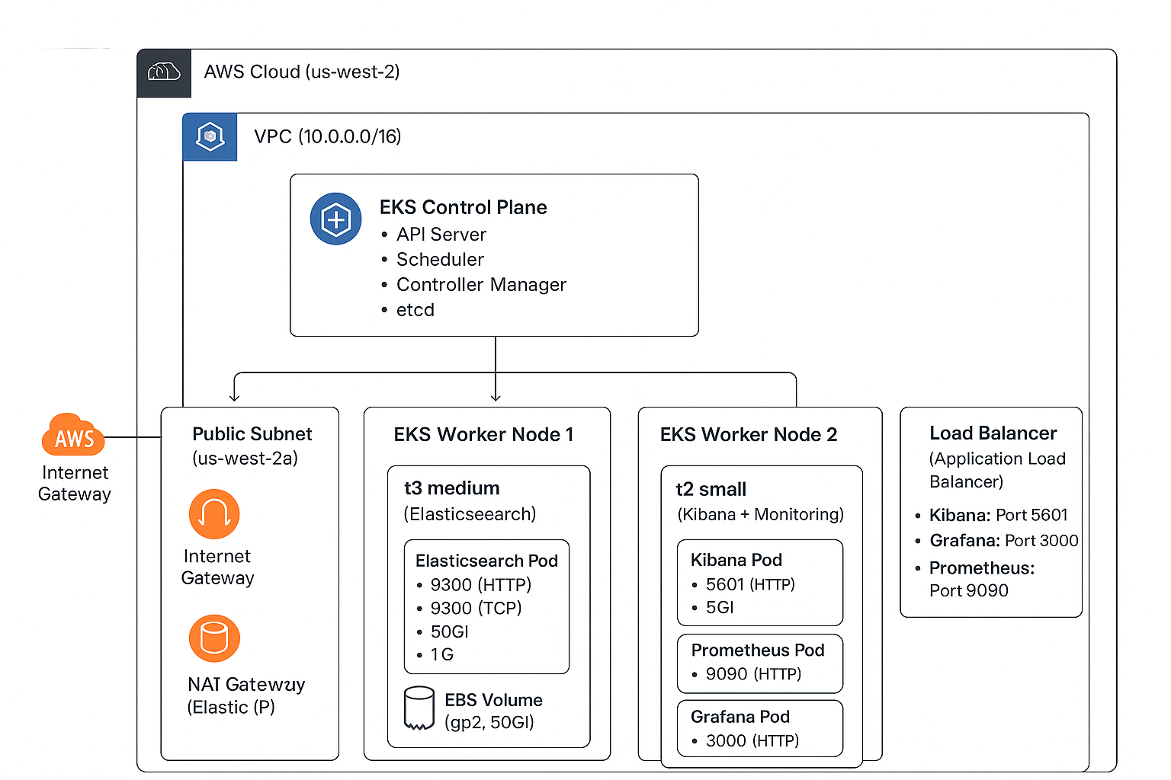

Slide 7
Prerequisites
Elastic Stack on EKS: Demo Setup
Section | Details | Notes
Prerequisites | Tooling 🛠️ • AWS CLI v2 • Terraform ≥ 1.2.2 • kubectl (EKS 1.29+) AWS Requirements 🔒 • IAM: EKS, EC2, VPC, IAM, S3 • Networking: ELB, Route 53 • Storage: EBS/EFS • Security: KMS, Secrets Manager | Quotas & Limits ⚠️ • VPCs: 5/region • EBS: 20 vols/region • Elastic IPs: 5+ • EKS Clusters: 100/account
Default Configuration | aws_region = us-west-2 cluster_name = elastic-demo-cluster node_type = t3.medium (2 vCPU) es_storage = 100 Gi (GP2) environment = demo | DNS-compatible names recommended
Demo Specs | EKS Cluster • v1.29 • 2–3 nodes (t3.medium/small) Elasticsearch • v8.11.0 • 2 replicas • 1 vCPU / 2 GB RAM Kibana • v8.11.0 • 2 replicas • 500m CPU / 1 GB RAM | Match versions for compatibility
Cost Optimization | ✓ Burstable instances (t3 family) ✓ GP2 volumes (over GP3) ✓ Auto-scaling (conservative limits) ✓ Basic CloudWatch monitoring

Slide 8

Quick Start Guide - Infrastructure as Code Deployment
1. Clone & Setup
2. Automated Script Workflow The provided script will automatically:
✅ Test Prerequisites – Check AWS CLI, Terraform, and kubectl installation.
✅ Test Configuration – Validate setup and create terraform.tfvars.
✅ Deploy Infrastructure – Run
✅ Set kubectl Config – Configure kubectl for your new cluster.
✅ Test Deployment – Verify pods are running.
✅ Show Connection Info – Display URLs and access details.

Slide 9
Access & Verification
Live Demo - Connect & Validate
3. Access Services
# Elasticsearch (JSON API)
kubectl port-forward svc/elasticsearch 9200:9200 -n elasticsearch &
curl http://localhost:9200
# Kibana (Web UI)
kubectl port-forward svc/kibana 5601:5601 -n kibana &
# Browser: http://localhost:5601 Username: elastic
Password: $(terraform output -raw es_password)
kubectl get svc -n elasticsearch # Verify LB creation
aws s3 ls $(terraform output -raw backup_bucket) # Check backups

Slide 10
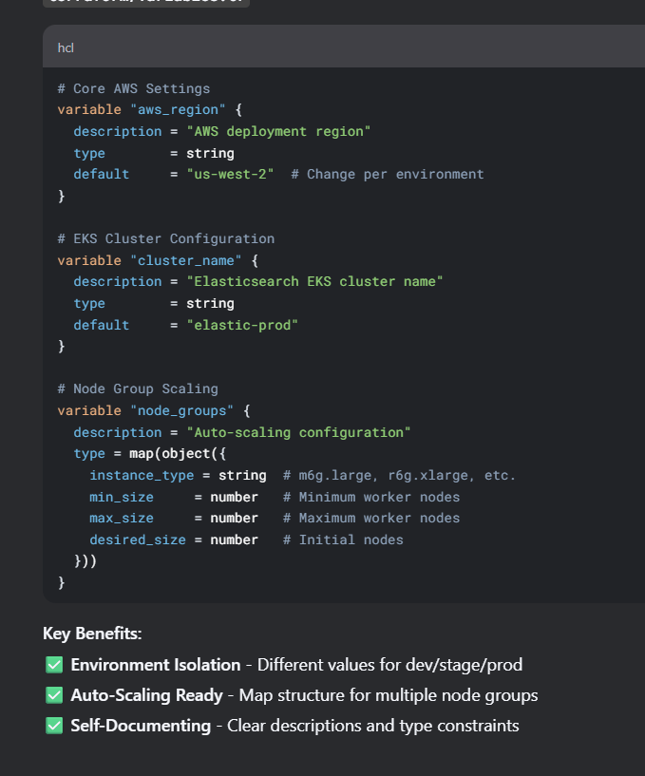
Code walkthrough

Slide 11
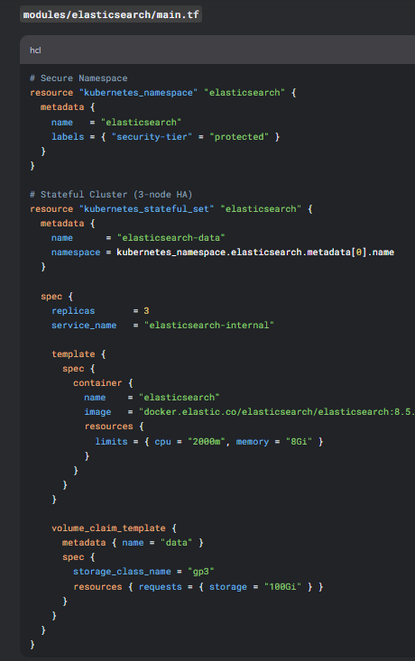
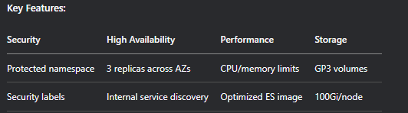
Elasticsearch Module – Best Practices

Slide 12
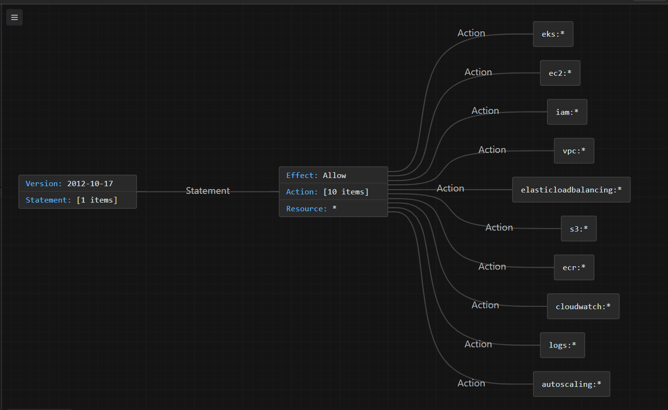
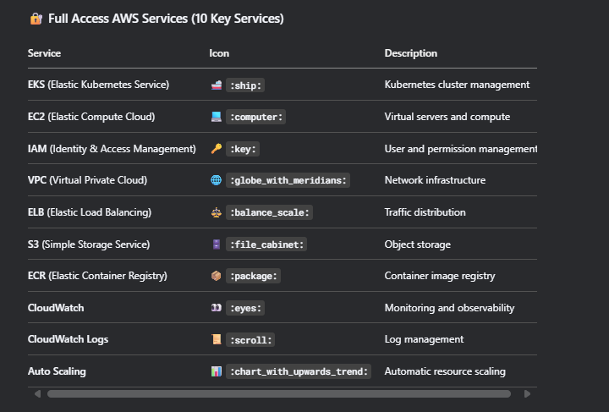
AWS IAM Policy Structure for Infrastructure Deployment
🔑 Key Point:
⚡ This policy grants administrative-level access for infrastructure deployment and management, enabling automated resource creation via tools like Terraform (:construction_site:).
🔑 Key Point:
⚡ This policy grants administrative-level access for infrastructure deployment and management, enabling automated resource creation via Terraform (:construction_site:).

Slide 13
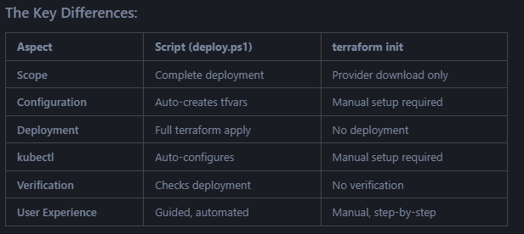
Behold! The Terraform Script That Built It All
EKS cluster - Kubernetes environment
Elasticsearch - Search and analytics engine
Kibana - Beautiful data visualization dashboard
Monitoring stack - Prometheus and Grafana
Load balancers - External access
All dashboards working - Ready to explore

Slide 14
Best Practices
Category | Features
🛠️ Modular Design | • Separate modules for each component • ♻️ Reusable and maintainable code • 🧩 Clear interfaces between modules
🔒 Security First | • 🔐 TLS encryption enabled • 🛂 RBAC for access control • 🌐 Network policies • 💎 Secrets management
🏭 Production Ready | • 🌍 Multi-AZ deployment • 📈 Auto-scaling capabilities • ❤️ Health checks • 💾 Backup & disaster recovery
💰 Cost Optimization | • 📏 Right-sized resources • 🏷️ Resource tagging • ⚙️ Configurable instance types

Slide 15
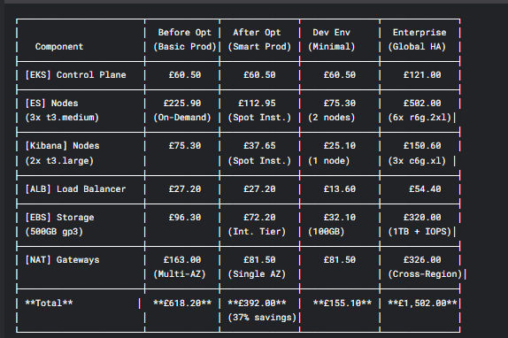
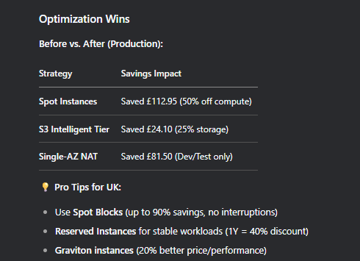
Cost Analysis

Slide 16
Community
Category | Resource | Type
📚 Documentation | Project README | Local File
 | Terraform Docs | Official
 | AWS EKS Docs | Official
 | Elasticsearch Docs | Official
👥 Community | Terraform Forum | Forum
 | AWS Developer Forums | Forum
 | Elastic Discuss | Forum
 | Kubernetes Slack | Chat
🛠️ Tools | Terraform Cost Estimation | Cost Tool
 | AWS Cost Explorer | Cost Tool
 | Kubernetes Dashboard | Monitoring

Slide 17
Thank you

